Slide 1

Chandigarh School of Business, Jhanjeri
Department of Computer Application
Program Code: NA
Program Name: MCA
Course Code: PGCA1937
Course Name: Cloud Computing
Prepared by: Dr. Gurvir Kaur

Slide 2

Outlines
PTU Syllabus of Unit-I
CO’s Introduction
Topic Overview
Brief description of what the presentation will cover
Importance or relevance of the topic
Key objectives or learning outcomes
Summary
References

Slide 3
PTU Syllabus of Unit-I
Part-A
Overview of Computing Paradigm: Recent trends in Computing -Grid Computing, Cluster Computing, Distributed Computing, Utility Computing, Cloud Computing.
Introduction to Cloud Computing: Vision of Cloud Computing, Defining a Cloud, Cloud Reference Model, Deployment Model, Characteristics, Benefits of Cloud Computing, Challenges ahead. Cloud computing vs. Cluster computing vs. Grid computing.
Migrating into a Cloud: Introduction, Broad approaches to Migrating into the Cloud, The Seven-Step Model of Migration Into a Cloud.
Virtualization: Introduction, Characteristics of Virtualized environment, Taxonomy of Virtualization techniques, Virtualization and Cloud Computing, Pros and Cons of Virtualization, Technology Examples- Xen, VMware, Microsoft Hyper-V.
Capacity Planning: Introduction, Defining Baseline and Metrics-Baseline Measurements, System Metrics, Load Testing, Resource Ceilings, Server and Instance types; Network Capacity, Scaling.

Slide 4
Key objectives or learning outcomes
CO1 Understand the basic concept and importance of cloud computing.
CO2 Access the suitability of migrating to a cloud solution for different applications.
CO3 Compare and evaluate the virtualization technologies.
CO4 Monitor and manage the cloud resources, applications and data while addressing the security concerns.
CO5 Use cloud solutions offered by industry leaders for various applications.

Slide 5
CO Introduction
CO NUMBER | TOPICS | LEVEL
CO1 | Overview of Computing Paradigm: Recent trends in Computing -Grid Computing, Cluster Computing, Distributed Computing, Utility Computing, Cloud Computing. Introduction to Cloud Computing: Vision of Cloud Computing, Defining a Cloud, Cloud Reference Model, Deployment Model, Characteristics, Benefits of Cloud Computing, Challenges ahead. Cloud computing vs. Cluster computing vs. Grid computing. | 2

Slide 6
Topic Overview
Evolution and Integration: Recent trends in computing, such as Grid Computing, Cluster Computing, and Distributed Computing, focus on optimizing resource utilization across multiple systems.
These paradigms enable parallel processing and resource sharing, improving performance, scalability, and fault tolerance.
Grid Computing uses distributed resources to solve complex tasks, Cluster Computing groups tightly coupled systems for enhanced performance, and Distributed Computing splits workloads across geographically dispersed networks.

Slide 7
Brief of what the presentation will
The presentation will cover the following points:
Trends in Computing
Grid Computing
Need
Uses
Types
Components

Slide 8
Importance of the topic
Scalability and Flexibility: Cloud computing provides on-demand access to a vast range of resources, enabling businesses to scale up or down based on their needs.
Cost Efficiency: By using cloud services, businesses can significantly reduce costs associated with maintaining and upgrading physical hardware.
Accessibility and Collaboration: Cloud computing allows users to access data and applications from any device with an internet connection, facilitating remote work and global collaboration. This enhances productivity, supports flexible work environments, and enables real-time collaboration across teams and locations.

Slide 9
Detail Topics
The ACM Computing Curricula 2005 defined "computing" as
"In a general way, we can define computing to mean any goal-oriented activity requiring, benefiting from, or creating computers. Thus, computing includes designing and building hardware and software systems for a wide range of purposes; processing, structuring, and managing various kinds of information; doing scientific studies using computers; making computer systems behave intelligently; creating and using communications and entertainment media; finding and gathering information relevant to any particular purpose, and so on. The list is virtually endless, and the possibilities are vast."

Slide 10
Grid Computing?
Pcwebopedia.com
  A form of networking. unlike conventional networks that focus on communication among devices, grid computing harnesses unused processing cycles of all computers in a network for solving problems too intensive for any stand-alone machine.
IBM
  Grid computing enables the virtualization of distributed computing and data resources such as processing, network bandwidth and storage capacity to create a single system image, granting users and applications seamless access to vast IT capabilities. Just as an Internet user views a unified instance of content via the Web, a grid user essentially sees a single, large virtual computer.
Sun Microsystems
  Grid Computing is a computing infrastructure that provides dependable, consistent, pervasive and inexpensive access to computational capabilities

Slide 11
Electrical Power Grid
Analogy
Electrical Power Grid
Users (or electrical appliances) get access to electricity through wall sockets with no care or consideration for where or how the electricity is actually generated.
“The power grid” links together power plants of many different kinds
Grid
Users (or client applications) gain access to computing resources (processors, storage, data, applications, and so on) as needed with little or no knowledge of where those resources are located or what the underlying technologies, hardware, operating system, and so on are
“The Grid" links together computing resources (PCs, workstations, servers, storage elements) and provides the mechanism needed to access them.

Slide 12
Grid Computing
Share more than information: Data, computing power, applications in dynamic environment, multi-institutional, virtual organizations
Efficient use of resources at many institutes. People from many institutions
working to solve a common problem (virtual organisation).
Join local communities.
Interactions with the underneath layers must be transparent and seamless to the user.

Slide 13
Need of Grid Computing?
Today’s Science/Research is based on computations, data analysis, data visualization & collaborations
Computer Simulations & Modelling are more cost effective than
experimental methods
Scientific and Engineering problems are becoming more complex & users need more accurate, precise solutions to their problems in shortest possible time
Data Visualization is becoming very important
Exploiting under utilized resources

Slide 14
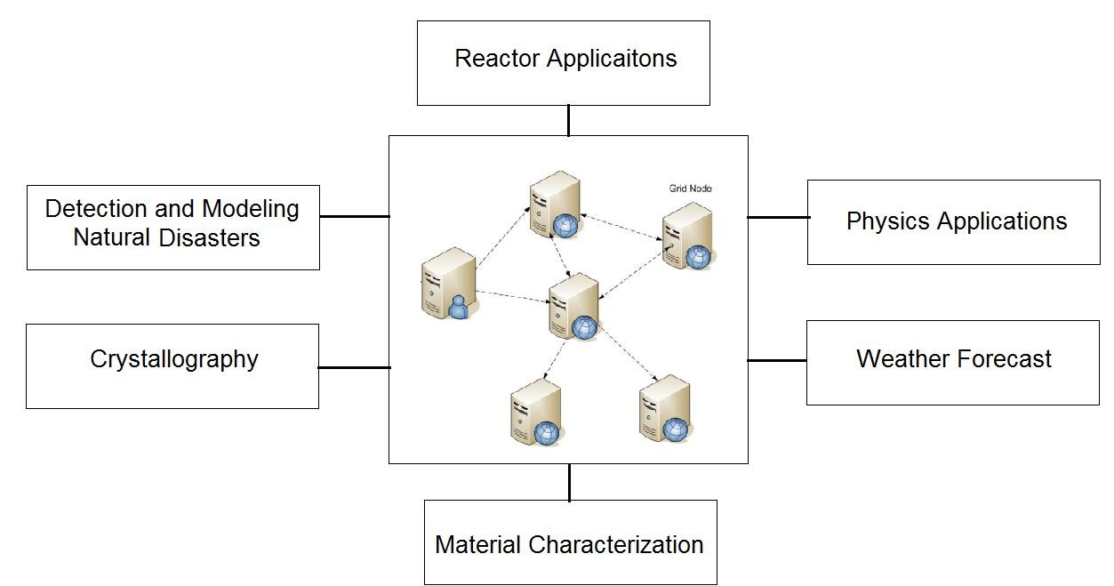
Who uses Grid Computing?

Slide 15
Type of Grids
Computational Grid: These grids provide secure access to huge pool of shared processing power suitable for high throughput applications and computation intensive computing.
Data Grid: Data grids provide an infrastructure to support data storage, data discovery, data handling, data publication, and data manipulation of large volumes of data actually stored in various heterogeneous databases and file systems.
Collaboration Grid: With the advent of Internet, there has been an increased demand for better collaboration. Such advanced collaboration is possible using the grid. For instance, persons from different companies in a virtual enterprise can work on different components of a CAD project without even disclosing their proprietary technologies.

Slide 16
Type of Grids
Network Grid: A Network Grid provides fault-tolerant and high-performance communication services. Each grid node works as a data router between two communication points, providing data-caching and other facilities to speed up the communications between such points.
Utility Grid: This is the ultimate form of the Grid, in which not only data and computation cycles are shared but software or just about any resource is shared. The main services provided through utility grids are software and special equipment. For instance, the applications can be run on one machine and all the users can send their data to be processed to that machine and receive the result back.

Slide 17
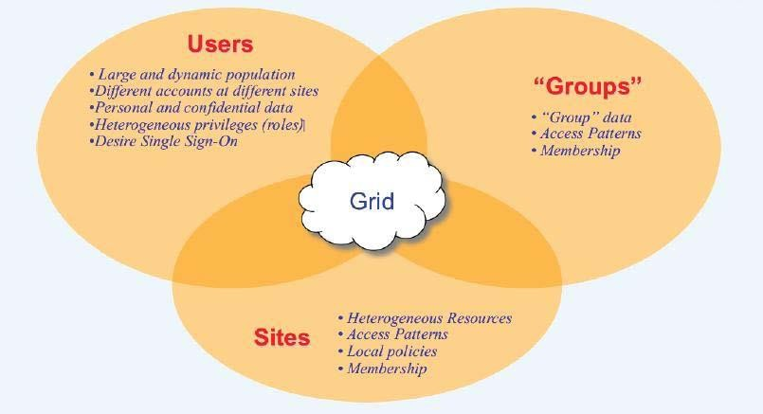
Grid Components
Source:KajariMazumdar “GRID: Computing Without Borders” Department of High Energy Physics TIFR,Mumbai.

Slide 18
Summary
Resource Sharing: Grid computing enables the pooling and sharing of computing resources (like processors, storage, and networks) across multiple organizations or locations to solve large-scale problems.
Distributed Architecture: It connects diverse, geographically distributed systems, creating a virtual supercomputer that allows for parallel processing, better resource utilization, and increased computational power.
Scalability: Grid computing allows for flexible scaling, as additional resources (hardware or software) can be easily integrated into the grid to meet growing computational demands.
Collaboration and Efficiency: It facilitates collaboration between organizations and enhances computational efficiency, often used in research, scientific simulations, data analysis, and tasks requiring high-performance computing (HPC).

Slide 19
References
Books References
Mastering Cloud Computing, Rajkumar Buyya, Christian Vecchiola, and ThamaraiSelvi, Tata McGraw Hill, ISBN-13: 978-1-25-902995-0, New Delhi, India,Feb 2013.
E-book link
https://archive.org/details/cloudcomputingbi0000sosi
YouTube link
https://www.youtube.com/@cloudcomputing351/videos
https://www.geeksforgeeks.org/cloud-computing/
https://www.tutorialspoint.com/cloud_computing/index.htm
https://nptel.ac.in/courses/106105167
https://www.edx.org/learn/cloud-computing

Slide 20
THANK YOU

